Slide 1

Projectworkphase1(19AI702)
AI Powered Advanced Web Application Firewall
Submitted by:
V.SRIRAM (212222103002)
R.SUROTHAAMAN (212222103003)
M.PAVITHRA (212222100032)
2022-2026 Batch
TEAM NO: 58
Under the guidance of:
V.SWEDHA
NAME OF THE GUIDE
V.SWEDHA
Designation,Department of IT
DEPARTMENT OF COMPUTER SCIENCE AND ENGINEERING(CS)
SAVEETHA ENGINEERING COLLEGE
(Autonomous Institution – UGC, Govt. of India)
(Affiliated to Anna University, Approved by AICTE - Accredited by NBA & NAAC – ‘A’ Grade - ISO 9001:2015 Certified)
Saveetha Nagar, Thandalam, Chennai-602 105, TamilNadu, INDIA.

Slide 2
Agenda
Introduction
Statement of the Problem
Scope of the Project
Methodology
Architectural Diagram
System Flow
Algorithm Used
Design
Use Case Diagram
Class Diagram
Sequence Diagram
Implementation
Important Code Segments
Output and Results
Test Cases
Conclusion
Future Work
References

Slide 3
Introduction
AI-Powered Advanced Web Application Firewall (WAF) is a security system designed to protect web applications from cyber threats.
With the rapid growth of web applications, attacks such as SQL Injection, Cross-Site Scripting (XSS), and DDoS have become increasingly common.
Traditional WAFs rely on static, rule-based mechanisms, which are often ineffective against evolving or unknown attacks.
Artificial Intelligence (AI) and Machine Learning (ML) enable intelligent traffic analysis and real-time threat detection.
This project integrates AI/ML techniques to create an adaptive and intelligent WAF that improves security dynamically.

Slide 4
Statement of the Problem
Develop an AI-powered WAF to protect web applications from cyber threats.
Use machine learning models to detect malicious web traffic.
Provide a real-time monitoring dashboard with alerts.
Improve accuracy and efficiency of threat detection.
Target Audience: Web developers, IT security teams, enterprises.
Deliverables:
Trained AI/ML model for traffic analysis.
Functional WAF system with monitoring dashboard.
Documentation of architecture, model, and performance.

Slide 5
Scope of the project
Focus:
AI-powered Web Application Firewall (WAF)
Real-time detection and blocking of cyber threats
Dashboard for monitoring traffic and alerts
Target Audience:
Web developers & administrators
Enterprises needing web security
IT security professionals
Deliverables:
AI/ML models detecting SQL Injection, XSS, DDoS
Functional WAF with monitoring & alerts
Documentation & scalable deployment

Slide 6
Scope of the project
Inclusions:
Collect and preprocess web traffic logs.
Extract features from HTTP requests and patterns.
Build AI/ML detection models.
Develop a user-friendly dashboard.
Implement real-time threat blocking and alerts.
Exclusions:
No hardware-level network security.
Not for non-web or offline applications.
No integration with third-party cloud security services.

Slide 7
Scope of the project
Data Collection: Use web traffic logs with labeled normal and malicious requests.
Preprocessing: Clean data and extract relevant features for ML analysis.
Limitations:
Dataset may not include all types of web attacks.
Real-time performance may depend on server capacity.
AI model accuracy may vary with unseen traffic patterns.
Continuous updates needed for evolving threats.

Slide 8
Methodology
Data Collection: Gather web traffic logs (normal and malicious requests).
Data Preprocessing: Clean data and extract features from HTTP requests and headers.
AI/ML Model Development: Train models to classify requests as safe or malicious.
Web Dashboard: Build a user-friendly interface for monitoring traffic and alerts.
Integration & Testing: Combine AI model with dashboard; validate accuracy and performance.

Slide 9
Methodology
Traffic Analysis & AI Integration:
Collect Traffic Data: Gather normal and malicious web requests.
Preprocess Data: Clean, normalize, and extract features from HTTP requests.
Develop AI/ML Model: Train models to classify requests as safe or malicious.
Web Dashboard: Create a user-friendly interface for monitoring and alerts.
Integration & Testing: Combine AI model with dashboard; test for accuracy and performance.

Slide 10
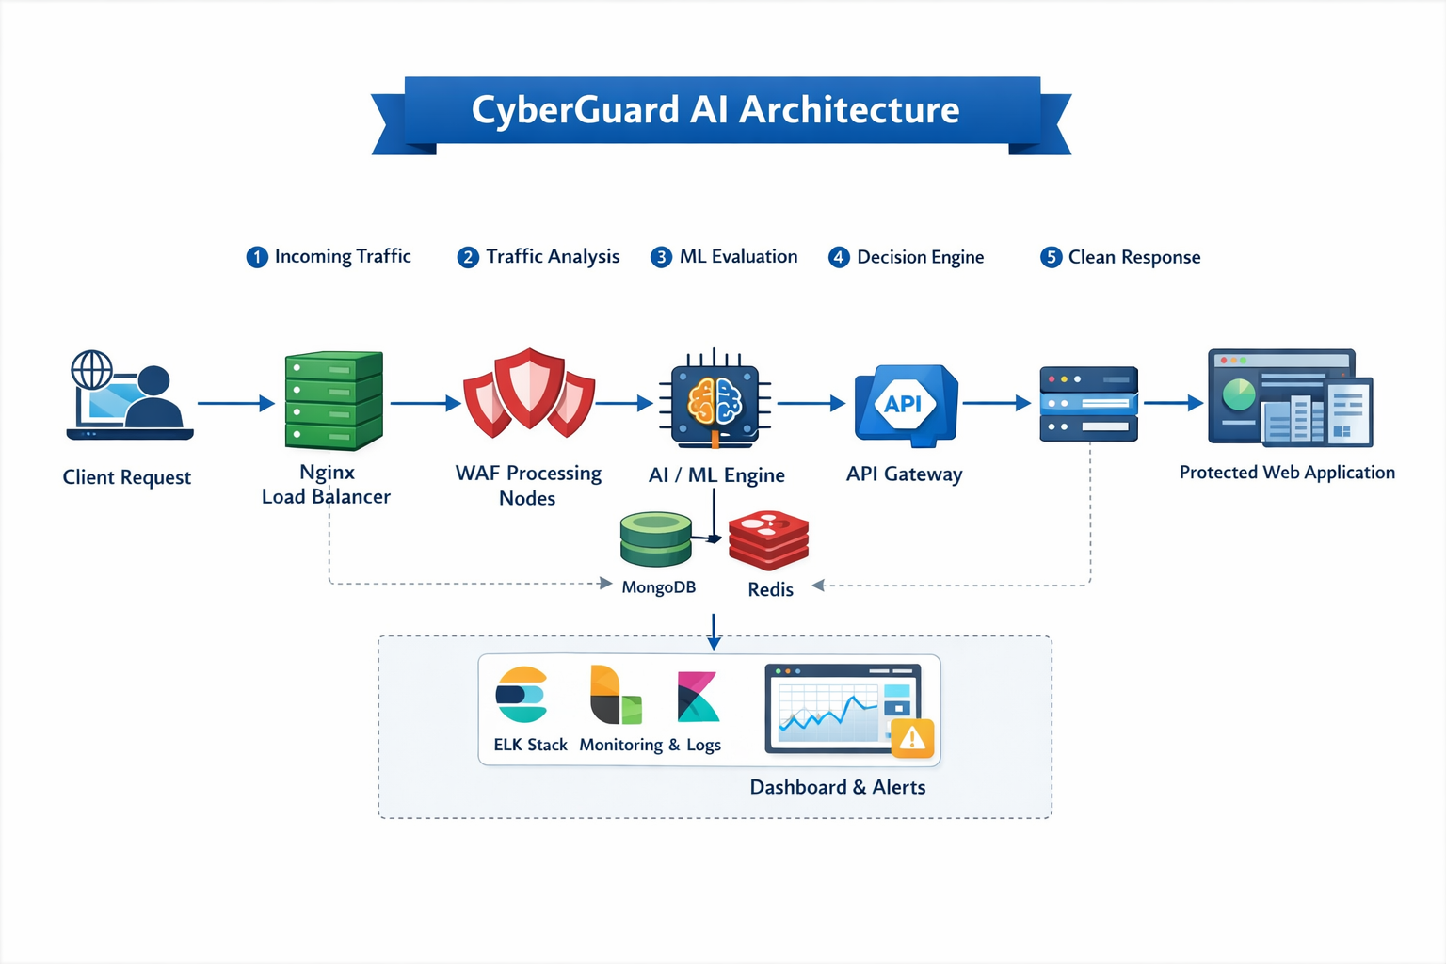
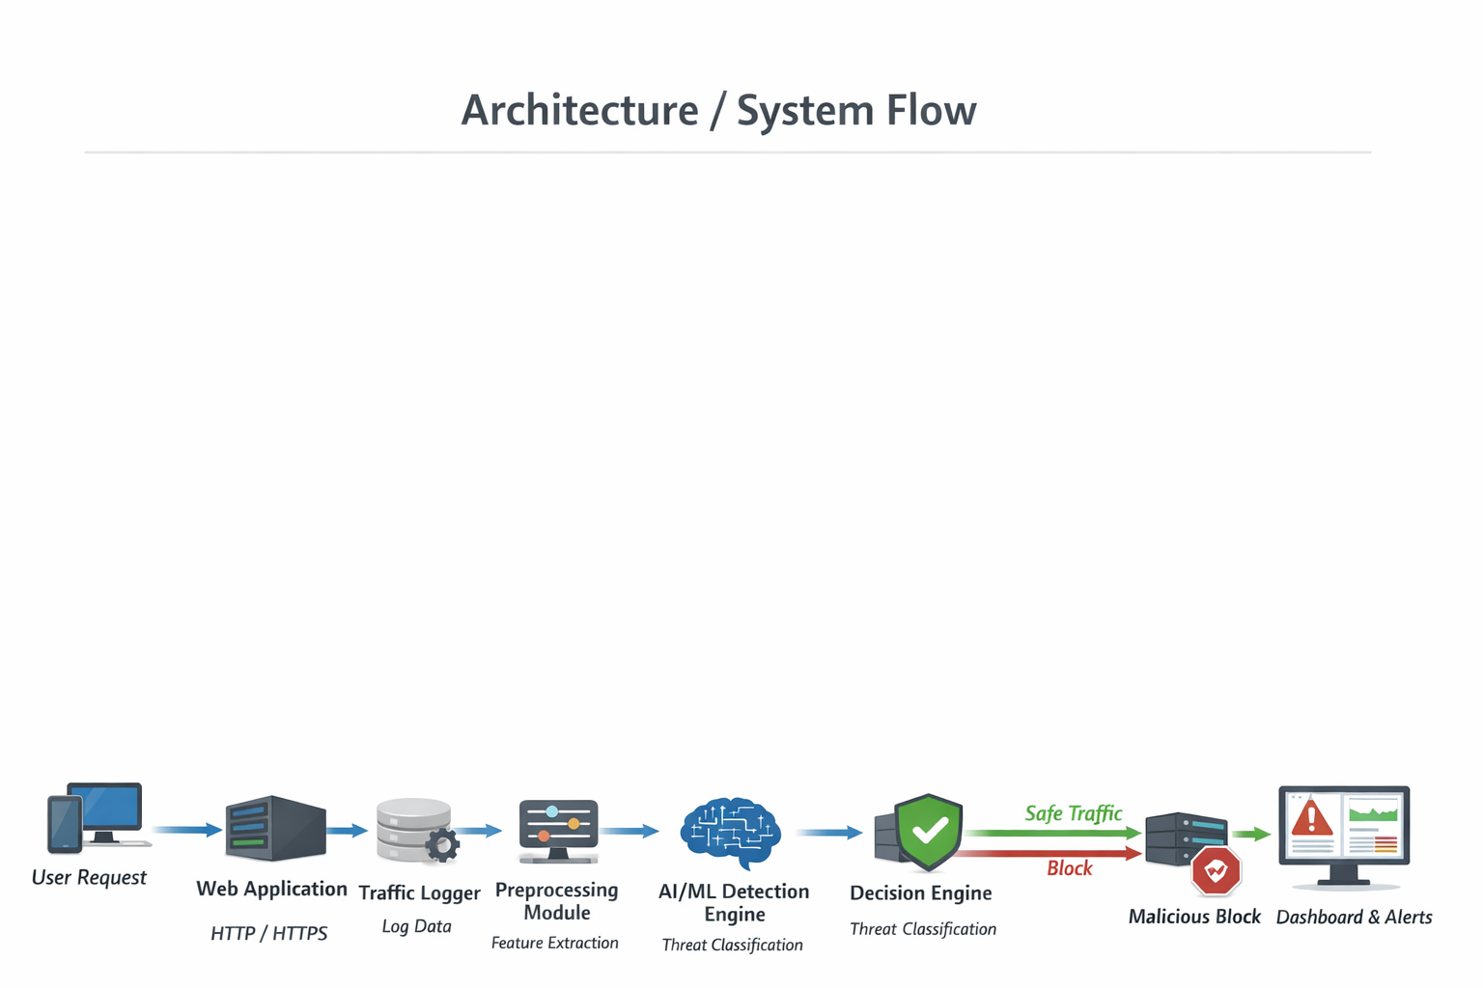
Architecture Diagram/Flow

Slide 11
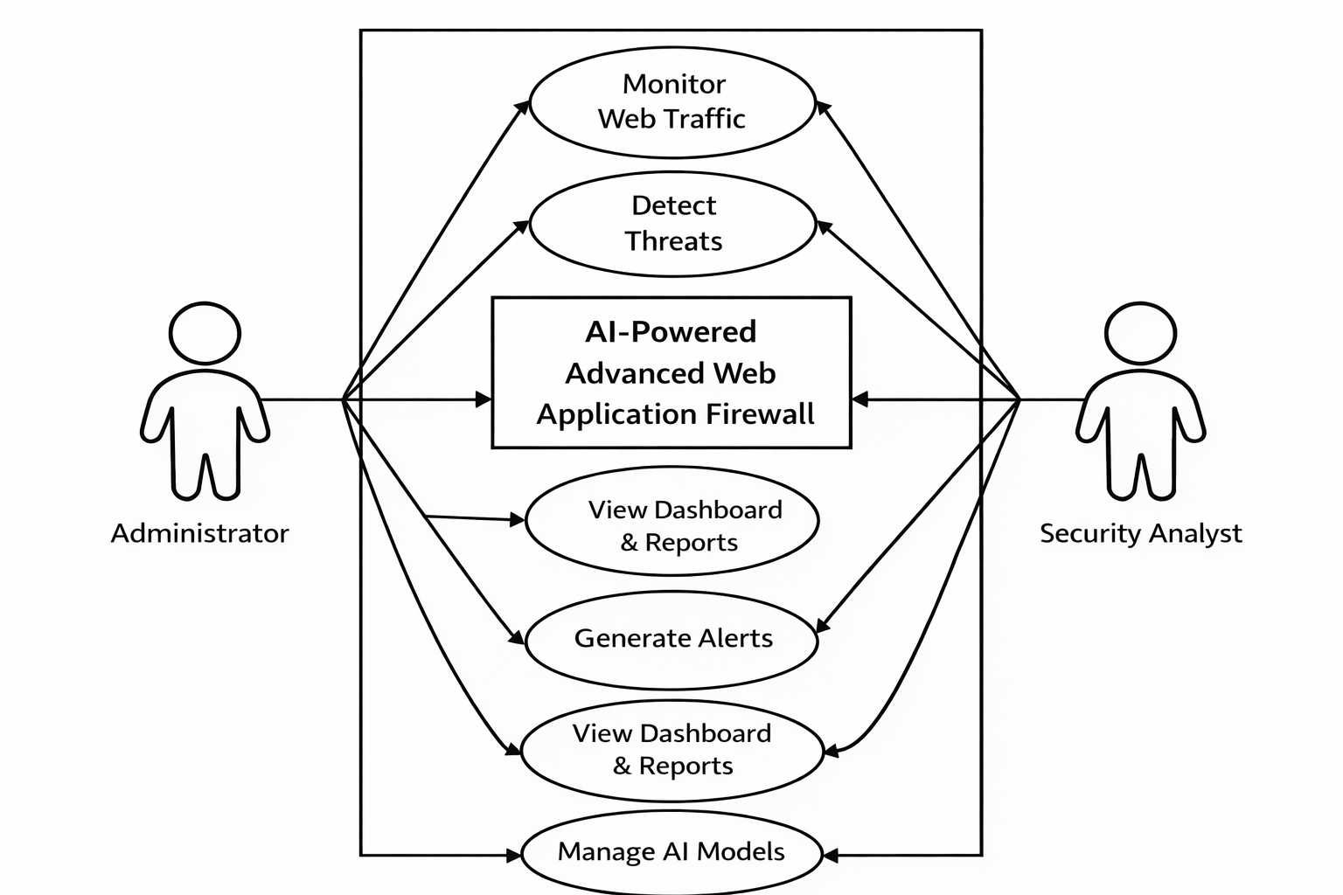
Design-Use Case Diagram

Slide 12
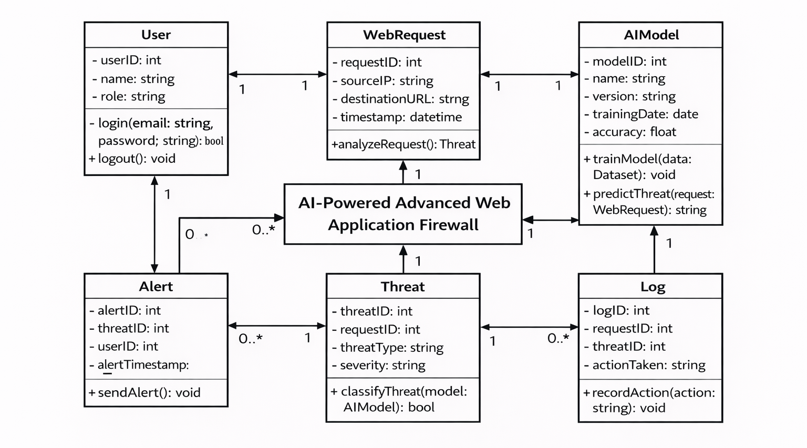
Design-Class Diagram

Slide 13
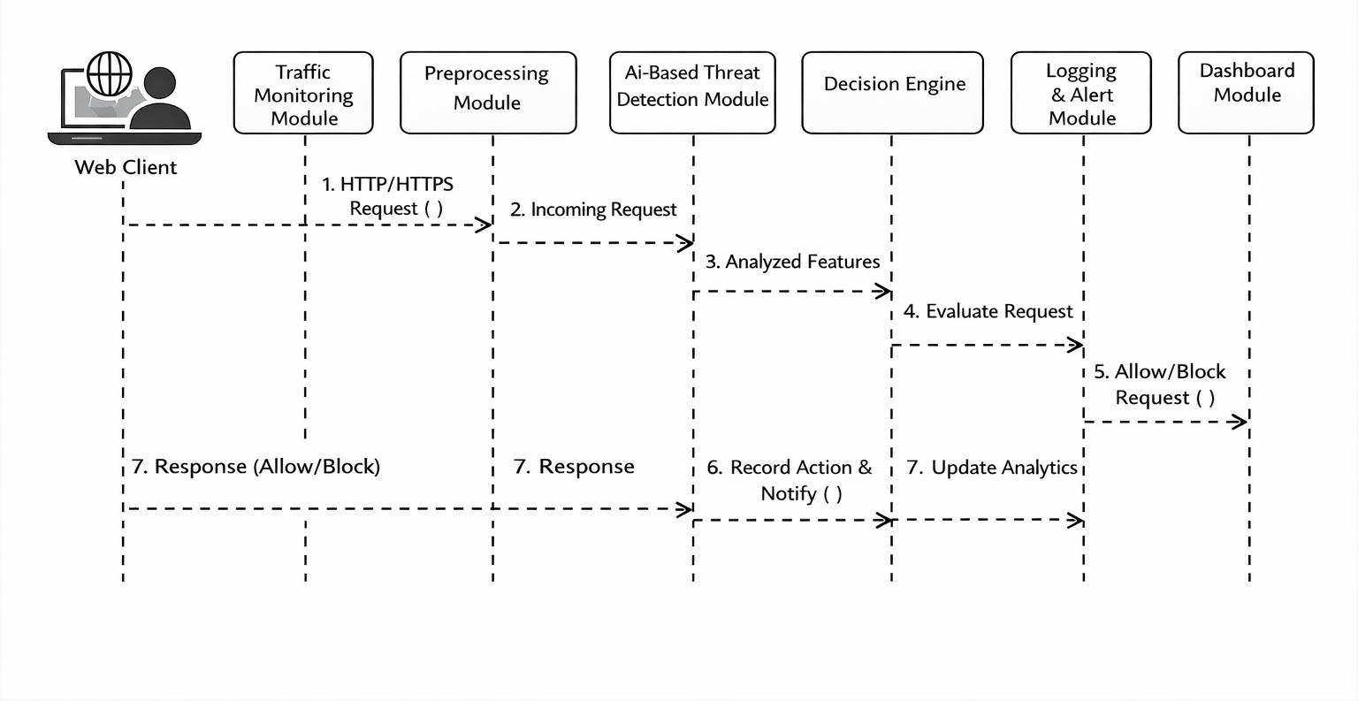
Sequence Diagram

Slide 14
Algorithms used
Machine Learning–Based Threat Detection Model:
The Machine Learning–based Threat Detection Model is used to analyze incoming web traffic in real time.
It classifies HTTP requests as normal or malicious based on extracted features from headers, URLs, and payloads.
It is trained using labeled web traffic data containing both legitimate and attack requests.
It improves detection accuracy without increasing response latency.
It enables adaptive learning by identifying new attack patterns and reducing false positives during request filtering.

Slide 15
Algorithms used
Anomaly Detection and Dynamic WAF Rule Generation Algorithm:
This algorithm identifies abnormal behavior by comparing incoming traffic patterns with normal baseline traffic.
It detects attacks such as SQL Injection, Cross-Site Scripting (XSS), and brute-force attempts.
Based on detected threats, it dynamically generates and updates Web Application Firewall rules.
It automatically blocks malicious requests and IP addresses in real time.
It ensures continuous protection by adapting firewall rules according to evolving attack behaviors.

Slide 16
Hardware and software selection
Hardware:
The project uses the following hardware components:
Server or cloud system for hosting the WAF
Load balancer (Nginx) for traffic distribution
Storage for logs and ML models
Network infrastructure for HTTP/HTTPS traffic
Software:
The project uses the following software components:
Python programming language
Flask / FastAPI framework
Machine learning using Scikit-learn
Nginx web server and load balancer
Docker and Docker Compose
Prometheus and Grafana for monitoring
Linux operating system

Slide 17
Implementation
The system is implemented using Python-based web technologies and containerized services.
Nginx is used as a load balancer to route incoming traffic to multiple WAF nodes.
HTTP requests are intercepted and analyzed using a security middleware.
Relevant features are extracted and passed to the machine learning engine.
The ML model classifies requests as normal or malicious.
Based on the prediction, dynamic WAF rules are generated to allow or block traffic.
All security events and metrics are logged and visualized using monitoring tools.

Slide 18
Important Code segments
Dynamic WAF Rule Generation (AI Driven)
def generate_rules_from_threats(self, threats):
if len(threat_list) >= 3:
rule = self._generate_rule_for_threat_type()
Description:
Uses ML threat predictions to create dynamic WAF rules
Generates rules for SQL Injection, XSS, Bot attacks
Automatically blocks IPs, URLs, User-Agents
Prevents duplicate rules and manages rule expiry

Slide 19
Important Code segments
Nginx Rule Conversion & Validation
def to_nginx_config(self):
return f"deny {self.condition};"
def _validate_nginx_config(self, config):
return syntax_check and security_check
Description:
Converts AI-generated rules into valid Nginx configuration
Validates:
Syntax correctness
Regex patterns
Security directives
Ensures safe deployment without server crash

Slide 20
Important Code segments
Secure Rule Deployment Across Nginx Nodes
async def deploy_rules_to_all_nodes(self, config):
await self._deploy_to_node(node, config)
Description:
Deploys WAF rules to multiple Nginx nodes
Supports Docker, API, and SSH-based deployment
Includes backup, rollback, and verification
Ensures high availability and fault tolerance

Slide 21
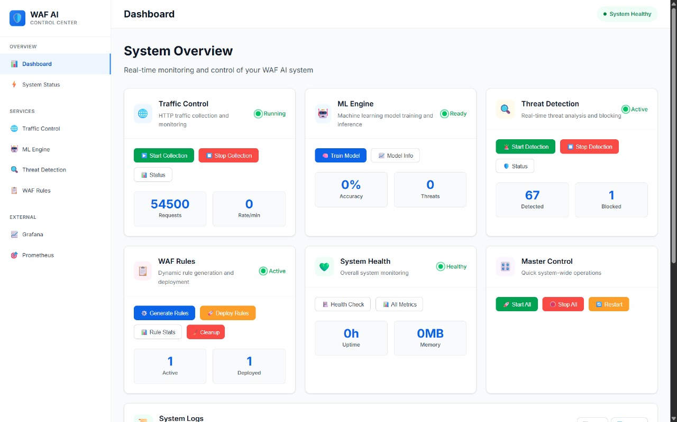
Output

Slide 22
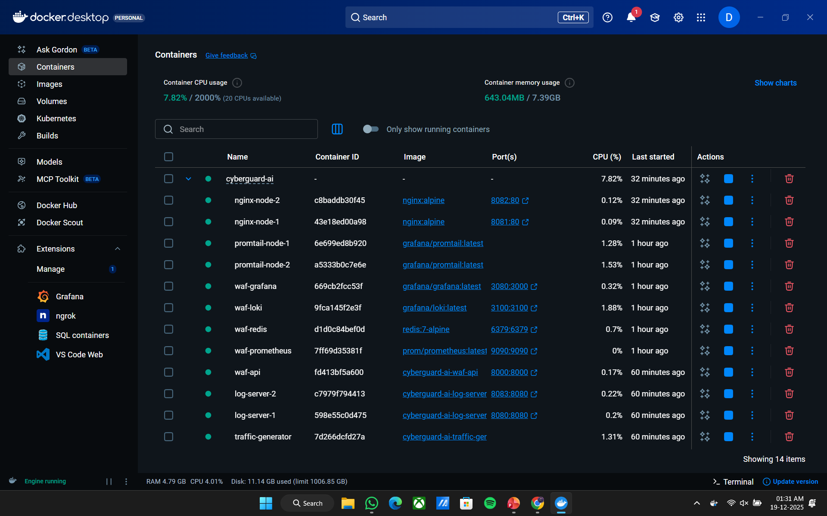
Output

Slide 23
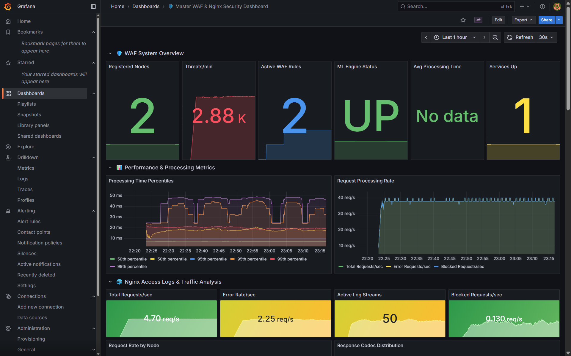
Output

Slide 24
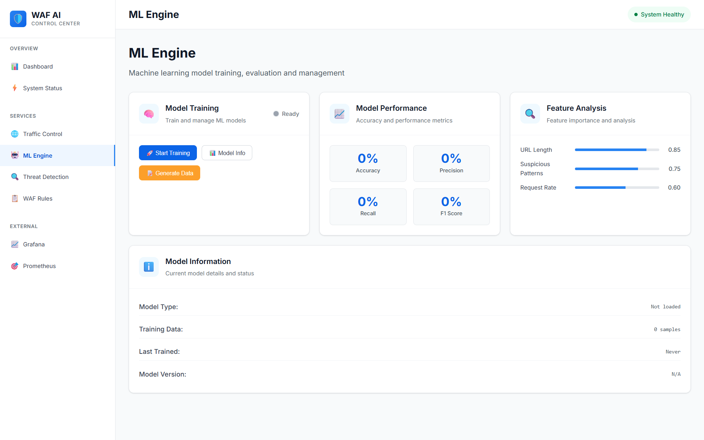
Output

Slide 25
Test Cases
S.No | Module | Test Case | Input | Expected Output | Actual Output | Status
1 | Authentication | Valid login | Admin username & password | Returns JWT token | JWT token returned, e.g., eyJhbGciOiJIUzI1NiIsInR5cCI... | Pass
2 | Authentication | Invalid login | Wrong credentials | 401 Unauthorized | 401 Unauthorized | Pass
3 | User Management | Add new user | Admin token + user data | 201 Created | 201 Created | Pass
4 | User Management | List users | Admin token | List of users | [{"id":1,"name":"John"},{"id":2,"name":"Alice"}] | Pass
5 | ML Engine | Train model | Sample training JSON | Training completes, model saved | Training completed successfully, model saved to models/ | Pass
6 | ML Engine | Predict threat | Test HTTP request data | Correct threat label | Threat label: SQL Injection | Pass
7 | ML Engine | Incremental training | New threat data | Model updated | Model updated with new threat data | Pass
8 | Traffic Collector | Start collection | Node URLs | Collector starts, logs traffic | Collector started on nodes: [node1, node2] | Pass
9 | Traffic Collector | Stop collection | Active nodes | Collection stops | Collection stopped for all nodes | Pass
10 | Traffic Stats | Fetch stats | Node ID | Traffic metrics JSON | {"requests":1200,"blocked":35,"anomalies":5} | Pass
11 | WAF Rules | Generate rules | Threat prediction data | Nginx rules file generated | nginx_rules.conf generated | Pass
12 | WAF Rules | Deploy rules | Node IDs + rules | Rules deployed to nodes | Rules deployed successfully to nodes [node1,node2] | Pass

Slide 26
Test Cases
13 | WAF Rules | Rollback rules | Node IDs | Rules reverted | Rules rolled back successfully | Pass
14 | Nginx Node | Add node | Node JSON | Node added, status OK | Node added: node3, status OK | Pass
15 | Nginx Node | Node status | Node ID | Node connectivity and health | Node node1 is UP, latency 20ms | Pass
16 | Control Panel | Service status | Access panel | Real-time status shown | Dashboard shows all services UP | Pass
17 | Control Panel | Start/Stop service | Service name | Service starts/stops successfully | Service WAF started successfully | Pass
18 | Monitoring | Grafana metrics | Access Grafana | Metrics displayed | Grafana dashboard displays CPU, memory, requests | Pass
19 | Monitoring | Prometheus metrics | /metrics endpoint | Correct metrics output | {"http_requests_total":1200,"threats_detected":35} | Pass
20 | Alerts | Slack/email alert | Threat detected | Alert sent | Alert sent to Slack/email for SQL Injection | Pass
21 | Security | Emergency shutdown | Admin token | All services stop | All services stopped, nodes [node1,node2] | Pass
22 | Security | Block IP range | CIDR + reason | IP blocked in WAF | IP range 192.168.1.0/24 blocked | Pass
23 | API | Rate limiting | High request volume | Requests limited | 429 Too Many Requests | Pass
24 | API | Unauthorized access | No token | 401 Unauthorized | 401 Unauthorized | Pass
25 | Logging | Access logs | HTTP requests | Logs stored and filtered | Logs stored in MongoDB, filtered by threat type | Pass

Slide 27
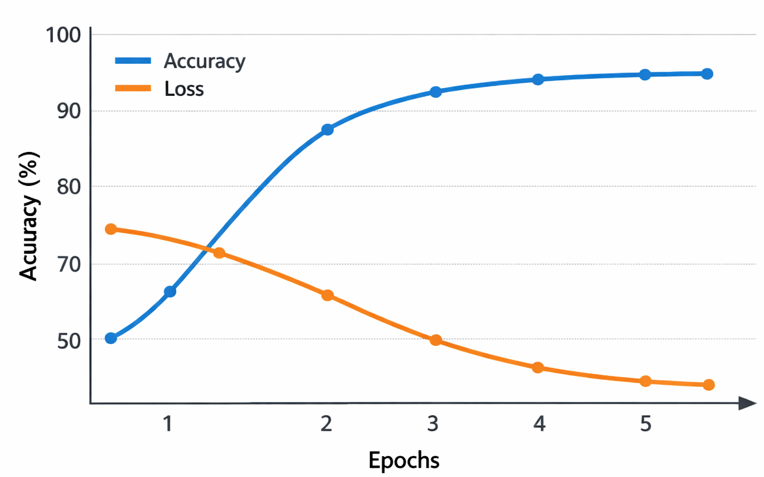
Results
Machine Learning Performance
Accuracy: 90%
Precision: 93%
Recall: 92%
Inference
Fast detection
Reliable predictions
Low false positives
Real-time analysis
Improved system security

Slide 28
Conclusion
The AI-Powered Advanced Web Application Firewall successfully demonstrates the use of machine learning to monitor and analyze web traffic in real time.
The system intelligently detects malicious requests, blocks potential threats, and dynamically generates security rules.
By combining automation with AI, the firewall reduces manual intervention, improves detection accuracy, and enhances overall web application security.
This project proves that AI-based WAF solutions are effective, scalable, and suitable for modern web environments.

Slide 29
Future Work
In future, the system can be enhanced by training the machine learning model with larger and more diverse real-world traffic datasets to improve detection accuracy.
Advanced deep learning techniques can be integrated to identify zero-day and evolving cyber attacks more effectively.
The firewall can be extended to support cloud-native and distributed environments with auto-scaling capabilities.
Integration with threat intelligence feeds and SIEM tools can further strengthen real-time threat response and security analytics.

Slide 30
References
A. Patcha and J. M. Park, An Overview of Anomaly Detection Techniques, Computer Networks, 2007.
N. Moustafa and J. Slay, UNSW-NB15: A Comprehensive Data Set for Network Intrusion Detection, IEEE, 2015.
Z. Alom et al., Intrusion Detection Systems Using Deep Learning Techniques, IEEE Access, 2019.
Project GitHub Repository: https://github.com/Darkwebnew/AI-Powered-Advanced-Web-Application-Firewall.git
Project Demo Video: Demonstration of AI-Powered Advanced Web Application Firewall (Self-Recorded)

Slide 31

Questions

Slide 32


